Slide 1
Machine Learning
Human detection
Nikhil and Nilesh (Group 2)

Slide 2
Task For the Week (till 10/05) :
Finding proper ML library
Choosing Programming language
Reading and capturing images .
Reading and capturing images from CCTV
Image Modification .

Slide 3
Tools We are using
PyCharm IDE -2020 edition
Python programming Language .(3.8.2version)
Libraries :
- numpy
- opencv-python

Slide 4
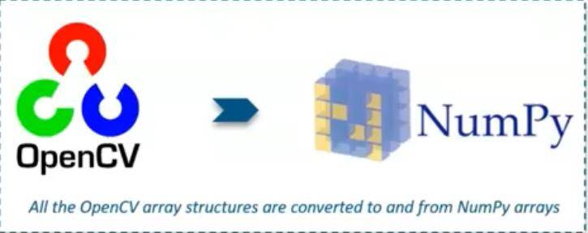
Libraries :

Slide 5
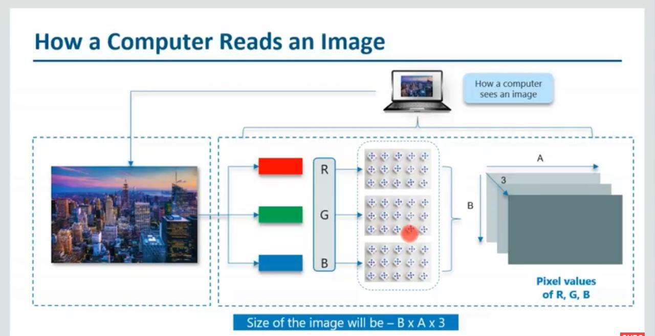

Slide 6
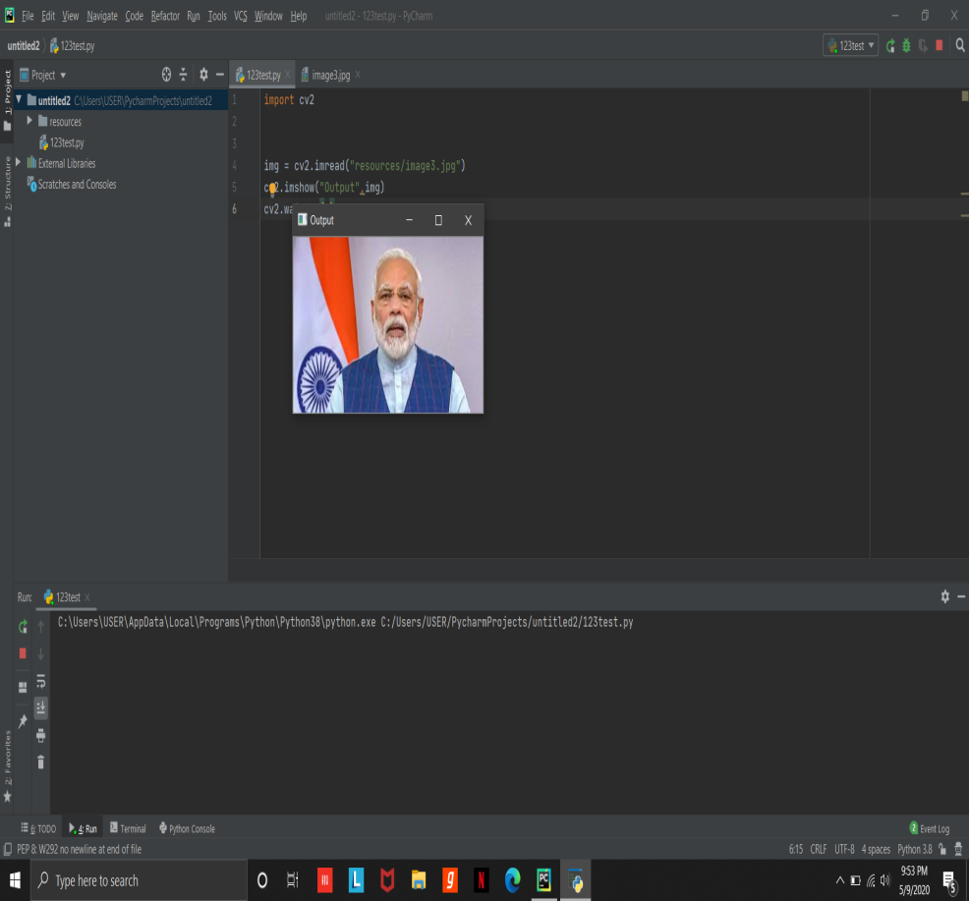
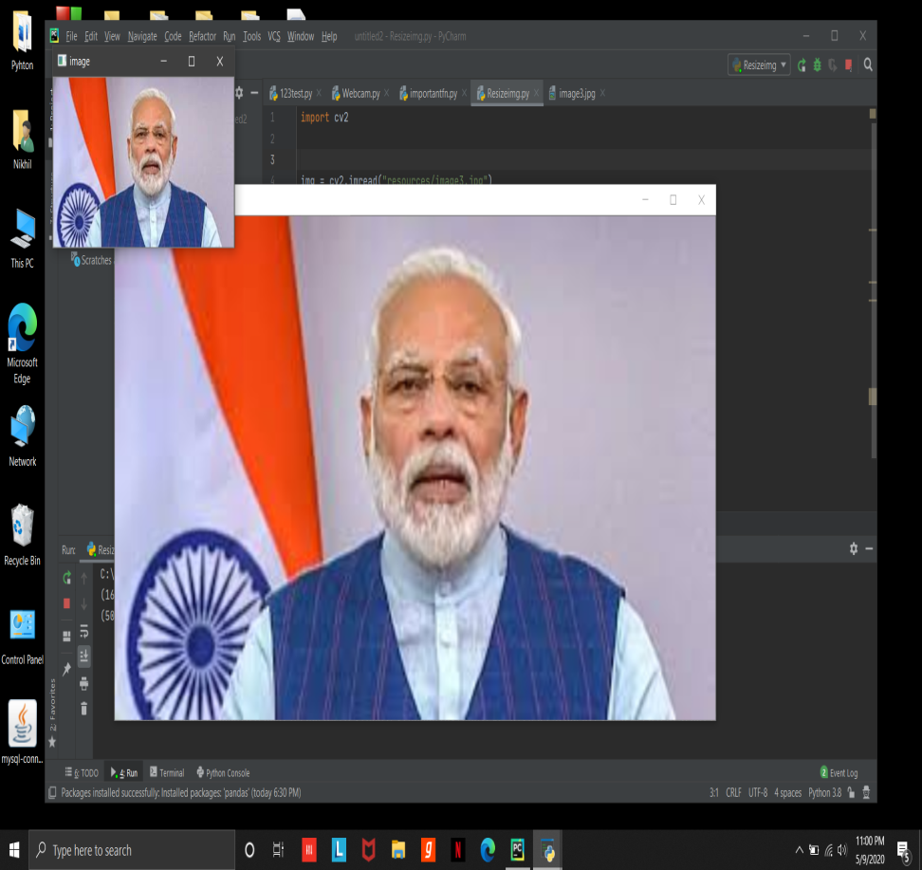
Reading and resizing image

Slide 7
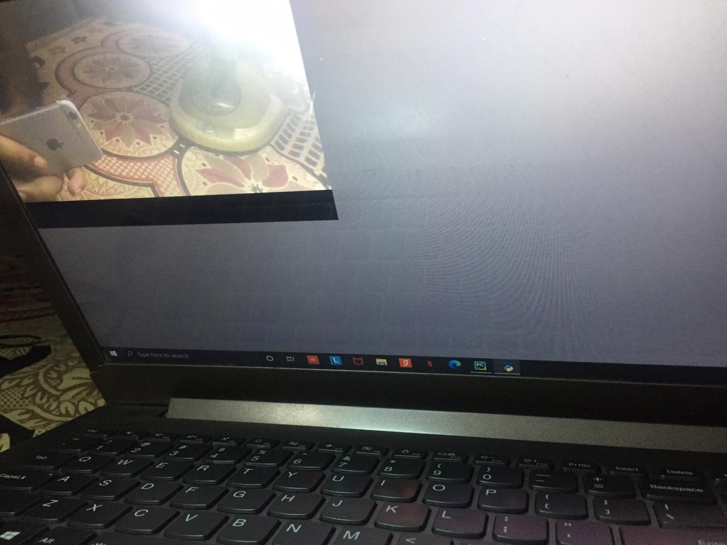
Reading image through webcam/CTTV

Slide 8
Task For Next Week (till 17/05)
To recognize human face from web cam.
Crop human face.
To store a human face in file.
To implement any suggestion insisted by mentor.

Slide 9
Software Tools Used :
Jupyter Notebook.
Open cv , numpy libraries.
Xml file :
1 . Harcasscade_frontalface_default.xml
2 . Harcasscade_eye.xml

Slide 10
Algorithm :-
Initialize webcam.
Loading the xml file.
Def face_extractor(img):
if isface :
return cropped image
else :
return None.
Save the image in the concerning folder.

Slide 11
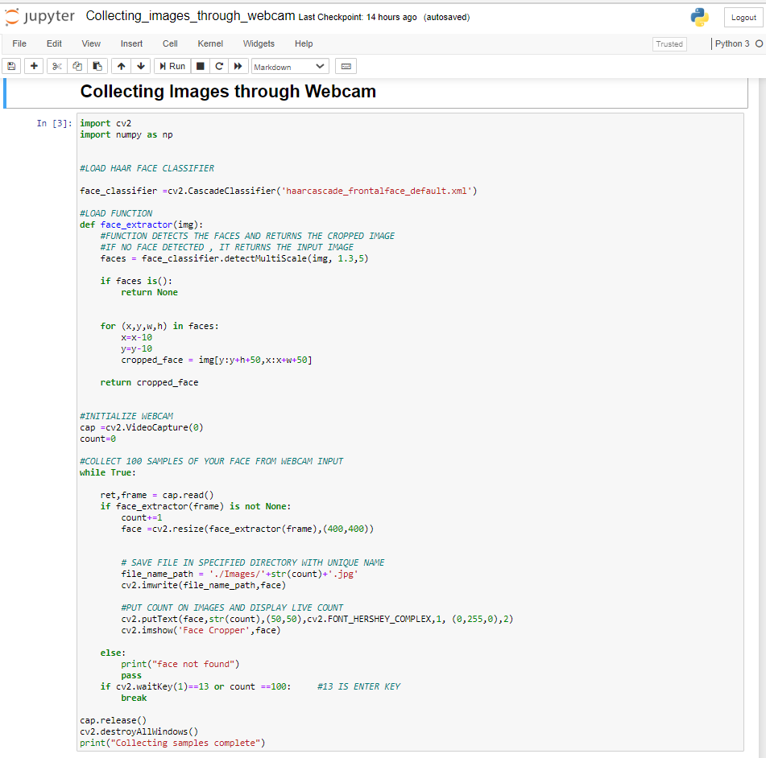

Slide 12
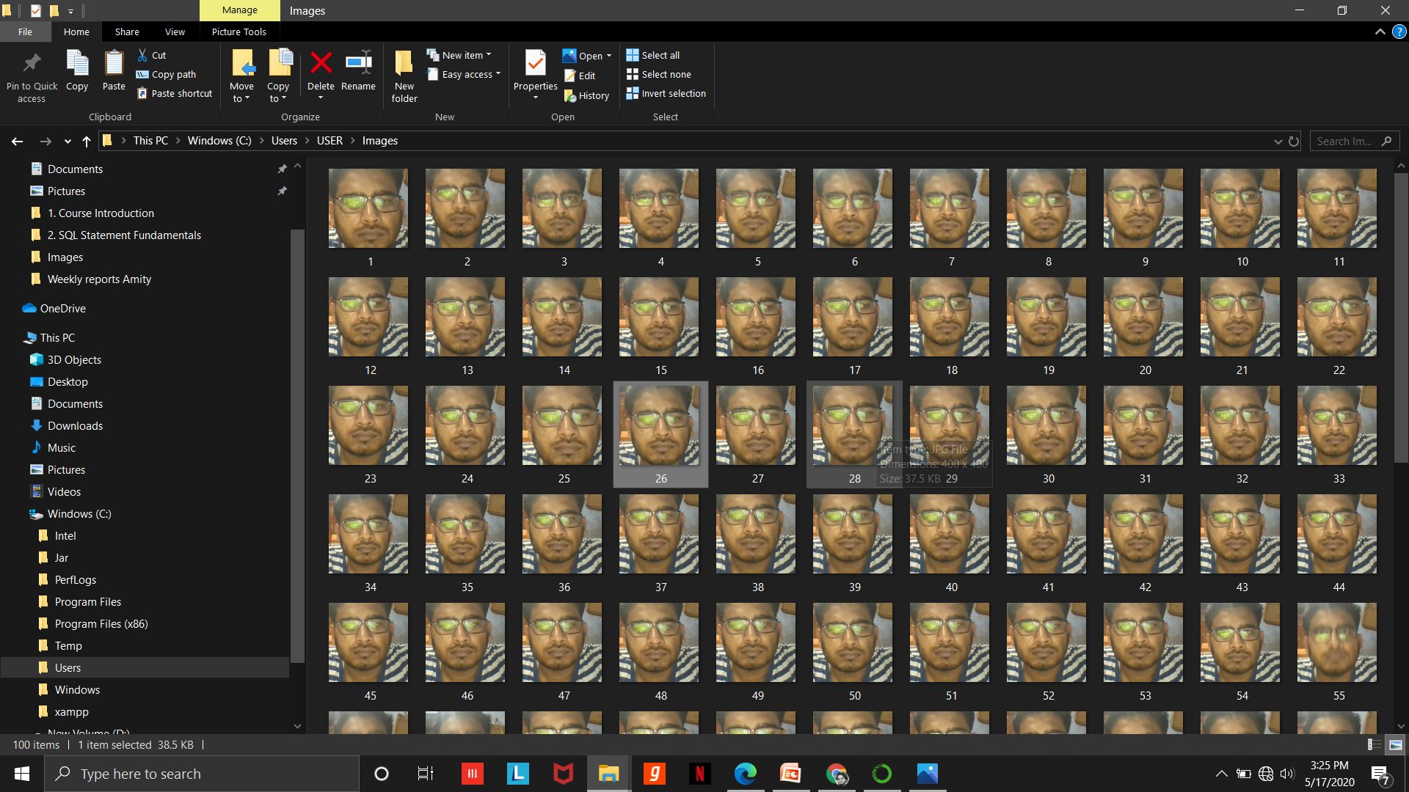
Collected Images:

Slide 13
Task for next week ( till 24/05)
Read multiple images .
Read images over masked face .
Start doing Docker.

Slide 14
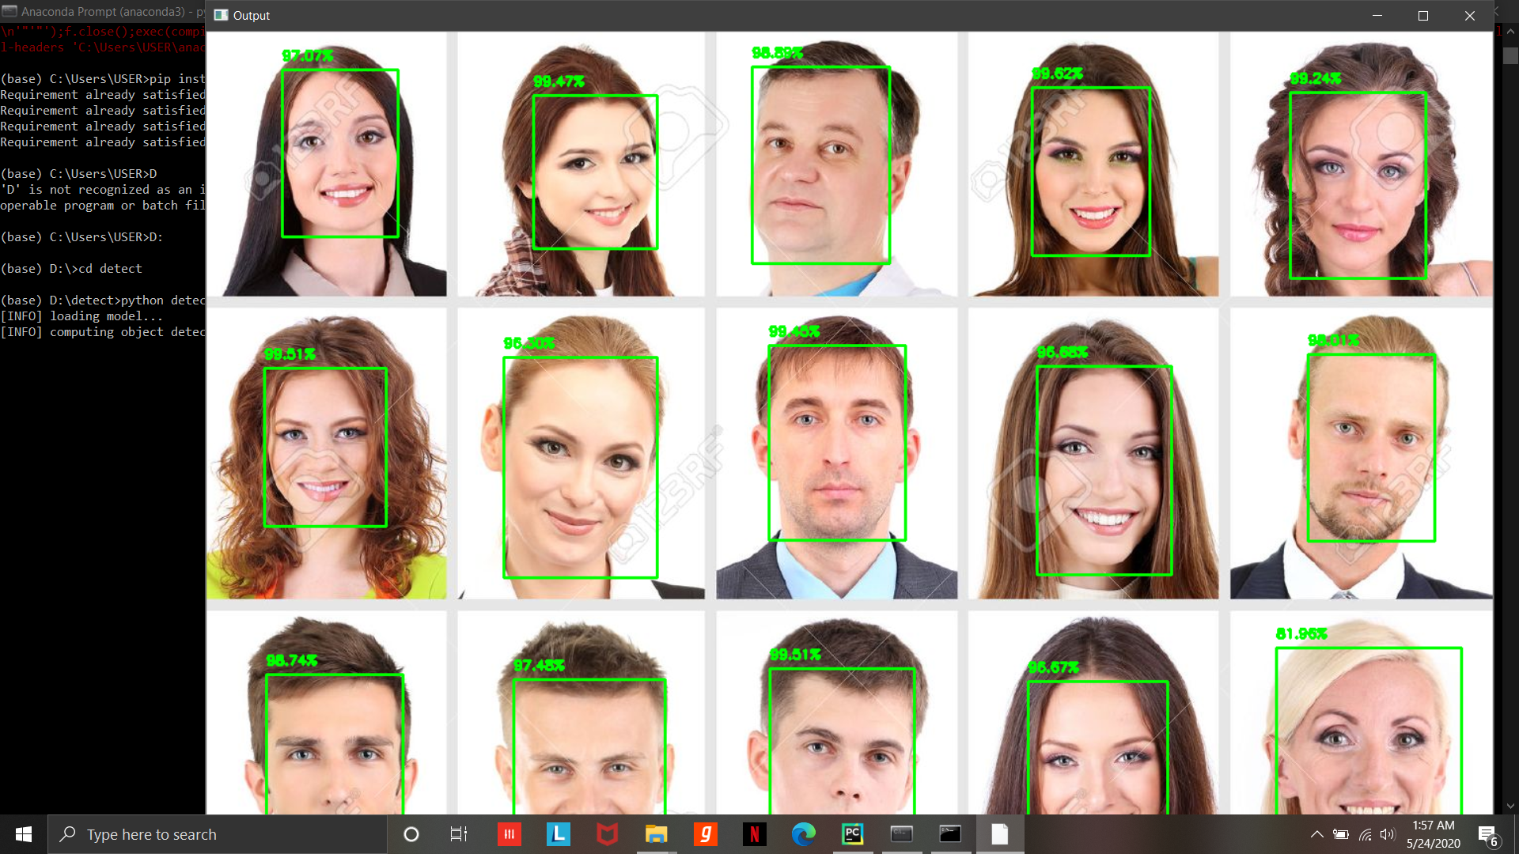
Detecting multiple faces :-
Notes:
Images are clear and separated

Slide 15
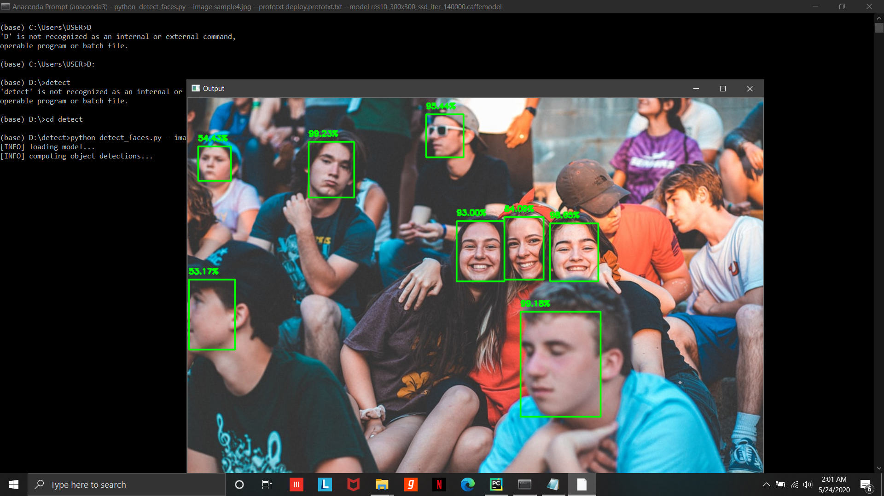
Notes:
Images are bunched and hazy

Slide 16
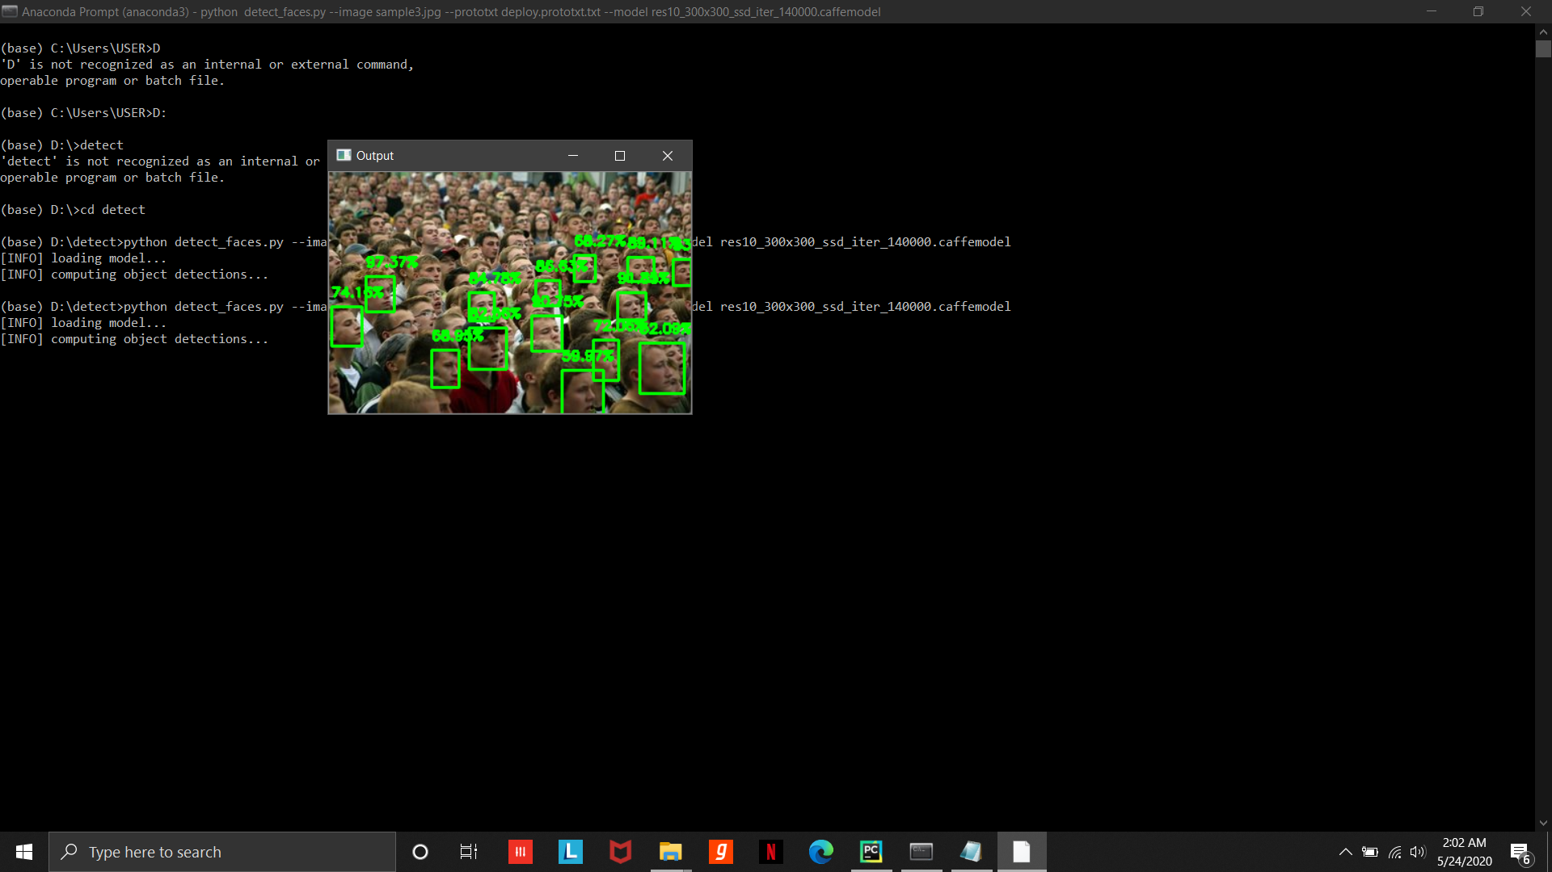
Notes:
Image with low resolution.

Slide 17
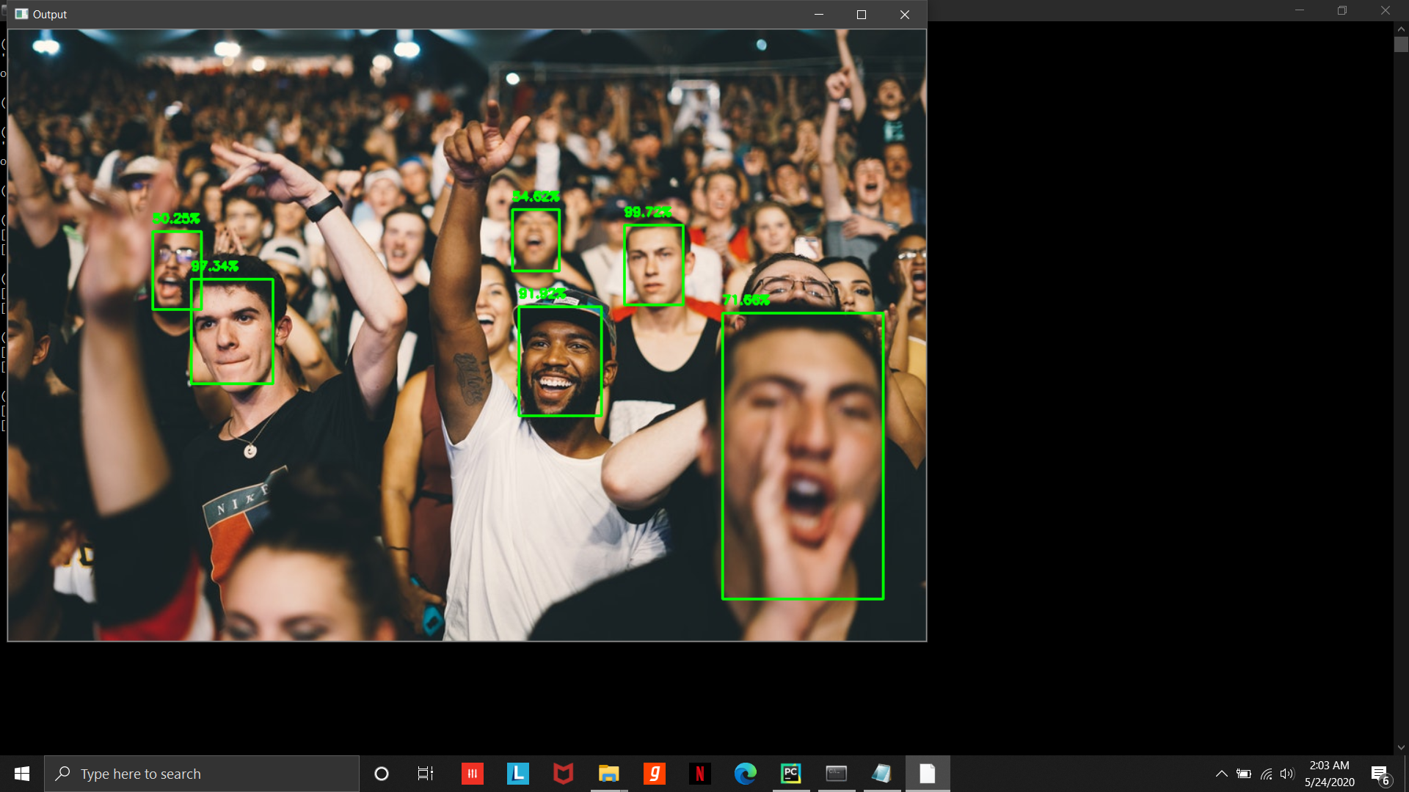
Notes:
Noisy image.

Slide 18
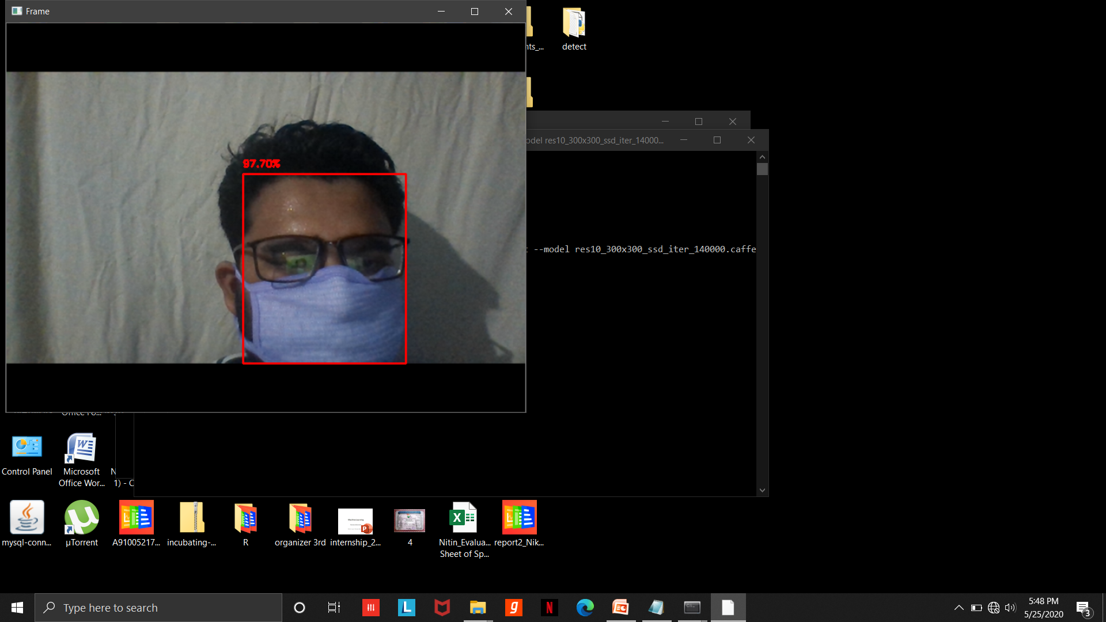
Notes:
Detecting image through webcam even with a mask.

Slide 19
Week Task (31st May)
Docker
Git
Identifying entire human body.
Weapon identification.

